Slide 1
PROJECT 7 CSC 685 ADVANCE MACHINE LEARNING
FROM MINSHU DUBEY & DANNI JIN

Slide 2
REQUIRENMENTS
Part I: RNN/LSTM/GRU
In this exercise, you are to work in your previous group on stock market forecast. Collect performance data for a period of 12 months for a favorite stock (Apple, Google, etc.) and perform the following tasks:
1) Use the most accurate model (LSTM or GRU) that best predicts the collected data pertaining to the past 12 months. Pay special attention to the selected units, activation functions, dropouts, dense layer configuration, etc.
2) Use your model from part 1 to make predictions for the next month, next 5 months, and the next 10 months.
3) Make sure to plot your results in both parts 1 and 2.
4) Fully discuss and justify your results.

Slide 3
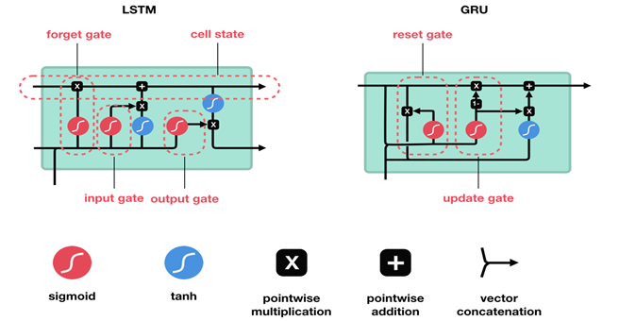
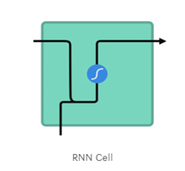
INTRODUCTION
RNNs are called recurrent because they perform the same task for every element of a sequence, with the output being depended on the previous computations. Another way to think about RNNs is that they have a “memory” which captures information about what has been calculated so far.
Both LSTM (Long short term memory) and GRU (Gate Recurrent Unit) have the goal of keeping long-term dependencies effectively while handling the vanishing/exploding gradient problems.
LSTMs do so via input, forget, and output gates.
GRUs operates using a reset gate and an update gate.

Slide 4
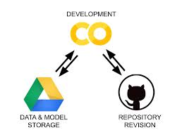

TOOLS USED
Google Colab
Python
GitHub

Slide 5

Stock Market Forecast Prediction Thought
We were told to take a dataset of stock like apple google etc of 12 months and perform prediction on that using RNN LSTM and GRU.
While discussing the project we thought to take two different stocks datasets and perform prediction on them and see is LSTM,GRU better at predicting time series problems on different datasets or it is on certain only.

Slide 6
Ranking Page
Minshu Dubey (50%)
Choose Microsoft Corporation Data of 12 Months
Did Requirements From 1 to 4
Report
Danni Jin(50%)
Choose Google Data of 12 Months
Did Requirements From 1 to 4

Slide 7
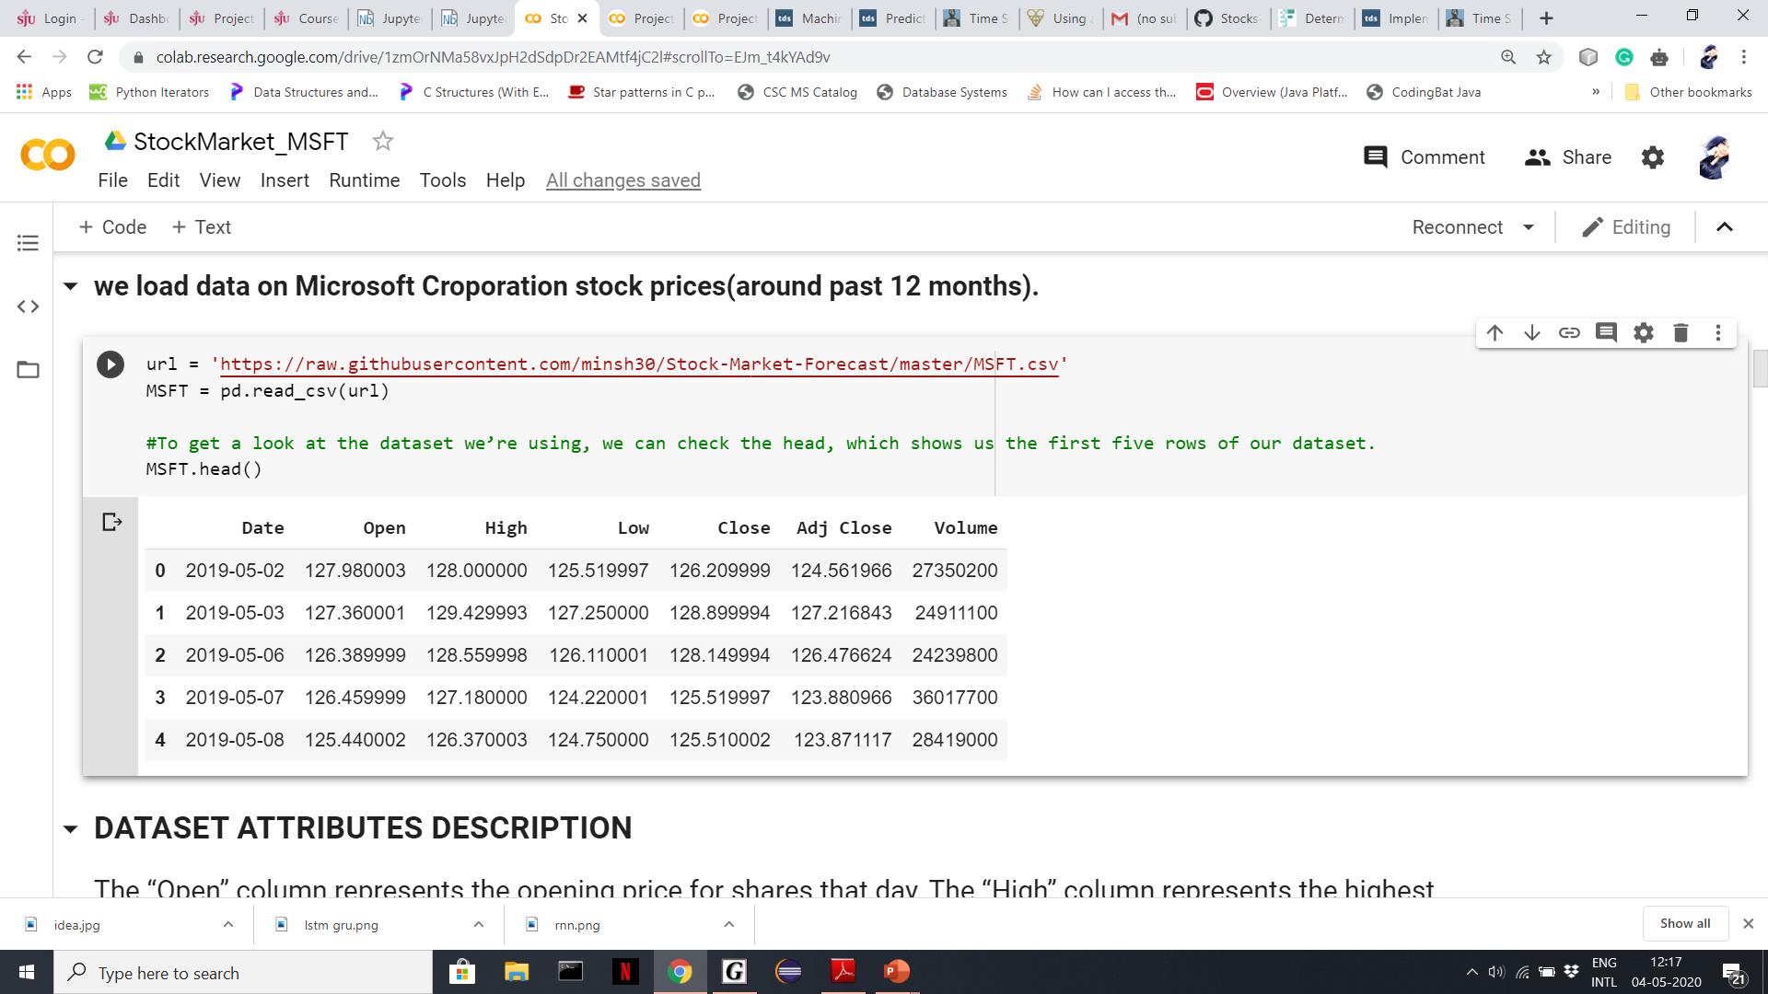
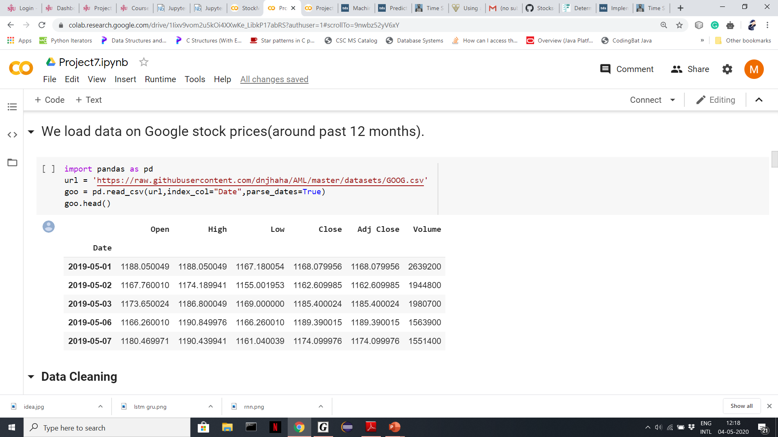
Dataset Importing and Viewing

Slide 8
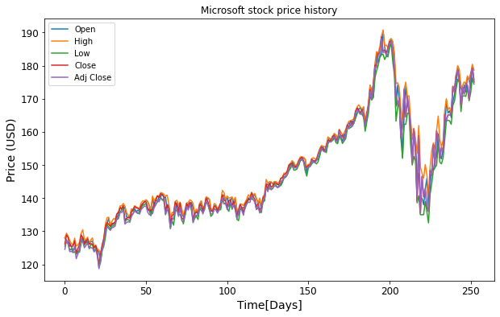
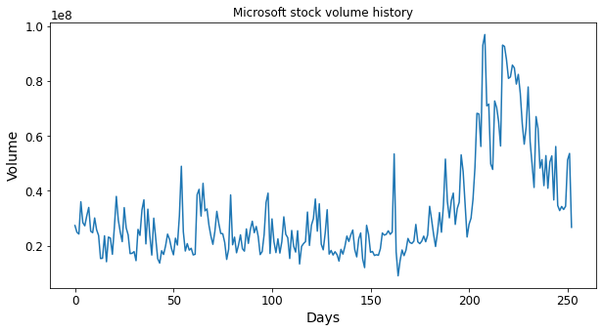
Data Visualization of Microsoft Stock

Slide 9
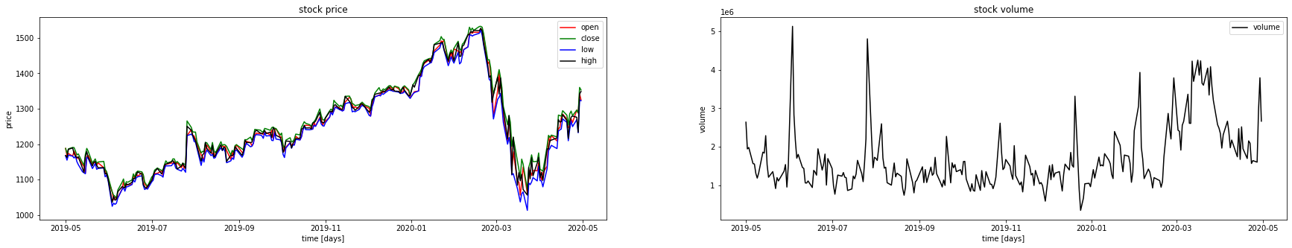
Data Visualization of Google Stock

Slide 10
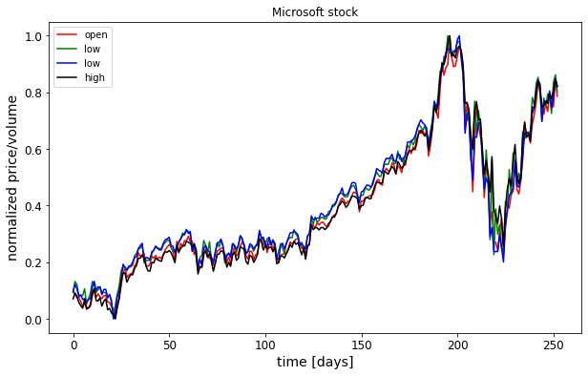
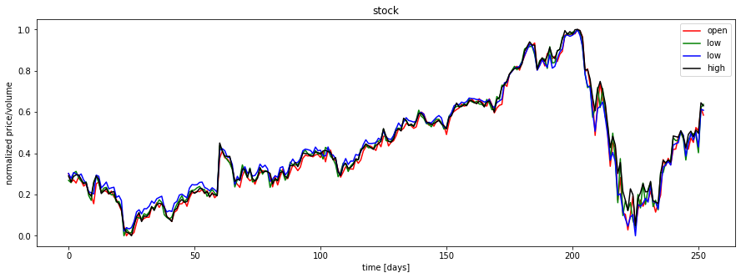
Data Visualization after Normalization

Slide 11
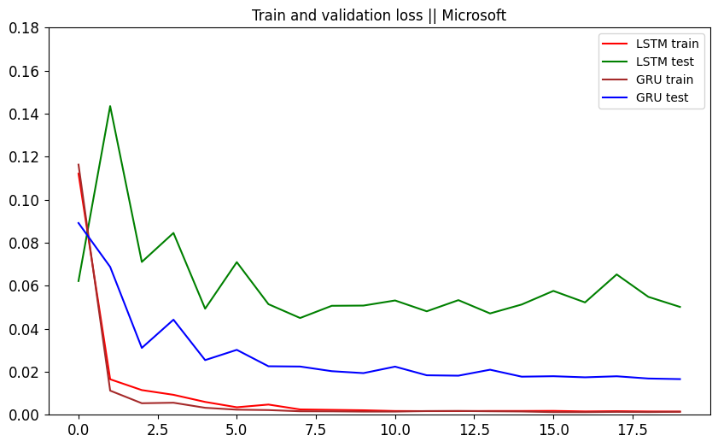
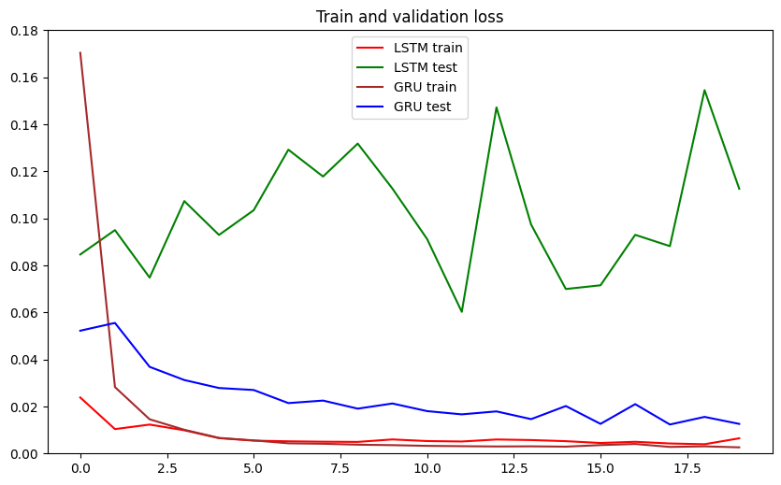
Training and Validation Loss Microsoft and Google

Slide 12
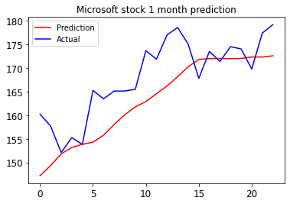
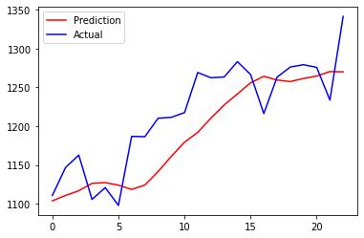
Prediction for next month in Microsoft and Google

Slide 13
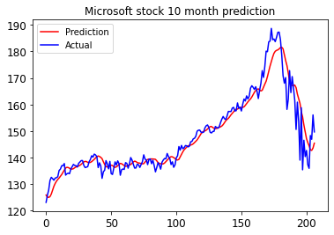
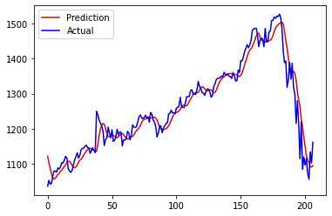
Prediction for next 5 and 10 Months in Microsoft and Google

Slide 14
Conclusion
GRU Model was less underfitted in comparison to LSTM model therefore choose GRU for prediction of next months.
While doing prediction of next 5 and 10 months the exact price points from our predicted price were almost close to the actual Price.
Though while predicting for next 1 month predicted points weren't that close to the actual points, but our model did still indicate overall trends such as going up or down. This project teaches us how easily we can predict time series problem with models like GRU and LSTMs. Gru is better than LSTM in computational efficiency also is a updated gate which needs less parameters and gates.
In our case we had small dataset that’s why GRU worked better than LSTM.
But in predicting time series problems not only GRUs but even LSTM give effective results.
While comparing both Microsoft and Google data results we can say in both the predictions were almost accurate to actual price and in result LSTMs and GRUs are predicting good at time series problem.

Slide 15
Thankyou

